Slide 1
The Structural Simulation Toolkit (SST)
The SST Team
SAND2018-8899 TR

Slide 2
Welcome!
Agenda
The SST Framework
Running a simulation
SST Element Libraries
Getting started running and extending SST
Tomorrow: OCCAM
Thursday: Deep dive?

Slide 3
Agenda
The SST Framework
SST Element Libraries
Running a simulation
Defining
Running
Generating statistics
Deep Dive: Network models

Slide 4



Instructors
Arun Rodrigues afrodri@sandia.gov
Gwen Voskuilen grvosku@sandia.gov
Si Hammond sdhammo@sandia.gov
Scott Hemmert kshemme@sandia.gov

Slide 5
References
Websites
http://www.sst-simulator.org/
https://github.com/sstsimulator
Configuration File Format:
http://sst-simulator.org/SSTPages/SSTUserPythonFileFormat/
Doxygen Documentation:
http://sst-simulator.org/SSTDoxygen/8.0.0_docs/html/
Developer FAQ:
http://sst-simulator.org/SSTPages/SSTTopDocDeveloperInfo/
Building SST
http://sst-simulator.org/SSTPages/SSTBuildAndInstall8dot0dot0SeriesQuickStart/
http://sst-simulator.org/SSTPages/SSTBuildAndInstall8dot0dot0SeriesDetailedBuildInstructions/

Slide 6
Another simulator?!
Problem: Simulation is slow
Tradeoff between accuracy and time to simulate
Many simulators are serial, with limited ability to model large, complex systems
Problem: Lack of simulator flexibility
Want to combine single-purpose simulations to model system behavior
Tightly-coupled simulators: faster but difficult to modify (e.g., change network topology…)
Adding new functionality often requires significant effort
The Structural Simulation Toolkit: A parallel, discrete-event simulation framework for scalability and flexibility

Slide 7
SST Project Goals
Parallel
Built from the ground up to be scalable
Parallelism over MPI, threads
Flexible
“Mix and match” models to build up a system
Customize architecture
Customize tradeoff between accuracy and simulation time
Network
CPU
CPU
Memory

Slide 8
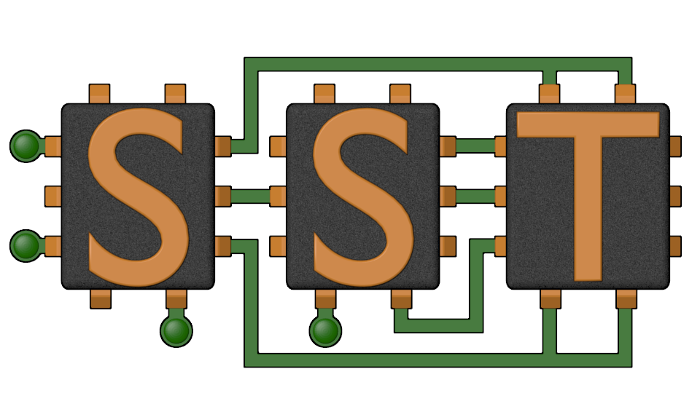
SST in a Nutshell
Parallel Discrete-Event Simulator Framework
Flexible framework enables multitude of custom “simulators”
Demonstrated scaling to over 512 processors
Comes with many built-in simulation models
Processors, memory, network
Open API
Easily extensible with new models
Modular framework
Open-source core
Time-scale independent core
Handles Micro-, Meso-, Macro-scale simulations
C++, Python

Slide 9
SST Architecture
SST Core framework
The backbone of simulation
Provides utilities and interfaces for simulation components (models)
Clocks, event exchange, statistics and parameter management, parallelism support, etc.
SST Element libraries
Libraries of components that perform the actual simulation
Elements include processors, memory, network, etc.
Compatible with many existing simulators: DRAMSim2, HMCSim, Spike, Ramulator, etc.
Component
Component
Component
Component
SST Core

Slide 10
SST: A Framework for Parallel Simulation
High-Level View

Slide 11
SST Building Blocks
SST simulations are comprised of components connected by links
Components communicate by sending events over the links
Every link has a minimum (non-zero) latency
Components define ports which are valid connection points for a link
Components can use subComponents and modules for extra functionality
SST Component
Core
SST Link
Latency: 1ns
SST Component
Cache
SST Link
Latency: 2ns
SST Component
NoC Router
SubComponent
Prefetcher
SST Link
Latency: 4ns
SST Component
Core
SST Link
Latency: 1ns
SST Component
Cache
SST Link
Latency: 2ns
SST Component
NoC Router

Slide 12
Key objects
SST::Component
CPU
SST::Component
Simulation model
SST::Link
Communication path between two components
Poll or interrupt with EventHandler
SST::Event
A discrete event
SST::Clock::Handler
Function to handle a clock tick
SST::SubComponent
Add functionality to Components
EventHandler
SST::Link
SST::Event
Load
SST::Event
Data
EventHandler
SST::Component
Cache

Slide 13

Component
Performs the actual simulation
Sends events over links to communicate with other components
Components define ports, links connect ports between components
Polled: Register a clock handler to poll the link
Interrupt: Register an event handler to be called when an event arrives
Can load SubComponents and Modules for additional functionality
Useful for parts of a component that should be swappable between simulations
Ex: scheduling algorithms, address mapping schemes, cache prefetchers
Useful for exposing interfaces to other components
Ex: network provides a subcomponent that can be loaded to handle traffic into/out of network
$$
NETWORK
CPU
CACHE
ROUTER
TRAFFIC GENERATOR
DIMM

Slide 14
SubComponents and Modules
Component: Core
Add additional functionality to a Component
SubComponent (SC): shares common base class with Component
Module (M): self-contained functionality (no access to Component class functionality
Provide modularity
Generic interface which can be used by multiple SC/M
Components load SC/M at runtime
Tightly-coupled with a component
Components call SC/M as a C++ class instance
Do not need to communicate via links
SC/M cannot exist by themselves
Example
Miranda core loads a pattern generator subcomponent to generate a sequence of memory ops
SubComponent: Stream Gen
or
Component: Core
SubComponent: SpMV Gen
or
Component: Core
SubComponent: Random Gen
Notes:
Finish: define subcomponent & module!

Slide 15
Link
Connects two components
Connect a specific “Port” on component A to a “Port” on component B
The ONLY mechanism by which components communicate
Necessary for parallel simulation
Has a minimum, non-zero latency for communication
Except self-links
Except during init/complete phases (untimed)
Transparently handles any MPI / threaded communication
Component A
Port X
Port Y
Component B
Link 1

Slide 16
Event
Unit of communication between two components
Packet format is up to the communicating components
Some standardized interfaces
Facilitates “mix and match” capability
sst-core/interfaces/
Memory (simpleMem)
Defines commands & event format for communication with caches & memory
Network (simpleNetwork)
Defines a packet format for events sent through a network component

Slide 17
Component/Link Interface
Components use these calls to manage links and events
SST::Component::configureLink()
Registers a link and (optionally) a handler
SST::Link::recv()
Pull an event from a link
SST::Link::send()
Push an event down a link
SST::Component::registerClock()
Register a clock frequency and a handler to be called on each clock tick

Slide 18
Simulating with SST

Slide 19
Simulating with SST
To define simulations, users create a python configuration file which:
Defines the components and subcomponents to use
Specifies the connectivity between components
SST then:
Loads the file and converts it to a graph
Partitions the graph for parallel simulation
Instantiates the components
Runs the simulation!

Slide 20
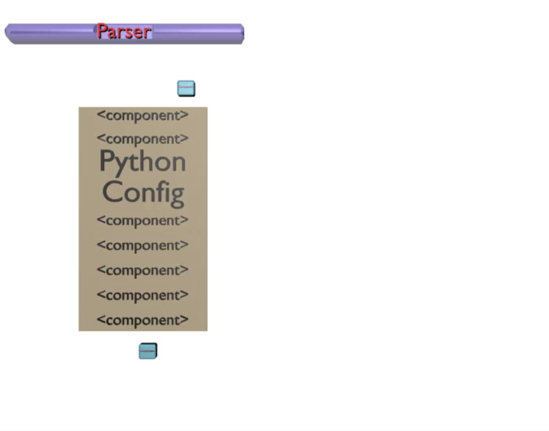
Simulation Configuration

Slide 21
Simulation Lifecycle
Birth
Create graph of components using Python configuration file
Partition graph and assign components to MPI ranks
Instantiate components
Connect components via links
Initialize components using their init() functions, multi-phase initialization
Setup components using their setup() functions
Life
Send events
Manage clock and event handlers
Death
Complete simulation using components’ complete() functions, multi-phase quiesce
Finalize components using their finish() functions
Output statistics
Cleanup simulation, delete components

Slide 22
SST in Parallel
MPI Rank 0
Comp0
Comp2
Comp4
Comp6
SST was designed from the ground up to enable scalable, parallel simulations
Components distributed among MPI ranks
And/or threads
Links allow parallelism
Hence, components should communicate via links only
Transparently handle any MPI/thread communication
Specified link-latency determines synchronization rate
Comp1
Comp3
Comp5
Comp7
Same configuration file
MPI Rank 0
MPI Rank 1
MPI Rank 2
MPI Rank 3
Comp0
Comp2
Comp4
Comp6
Comp1
Comp3
Comp5
Comp7
Notes:
Links handle serialization

Slide 23
Running SST and Code Orientation

Slide 24
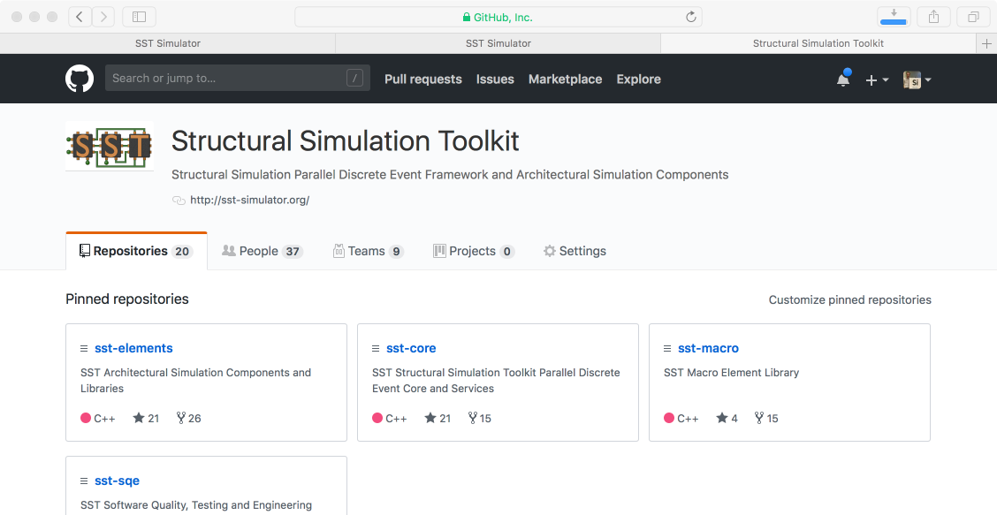
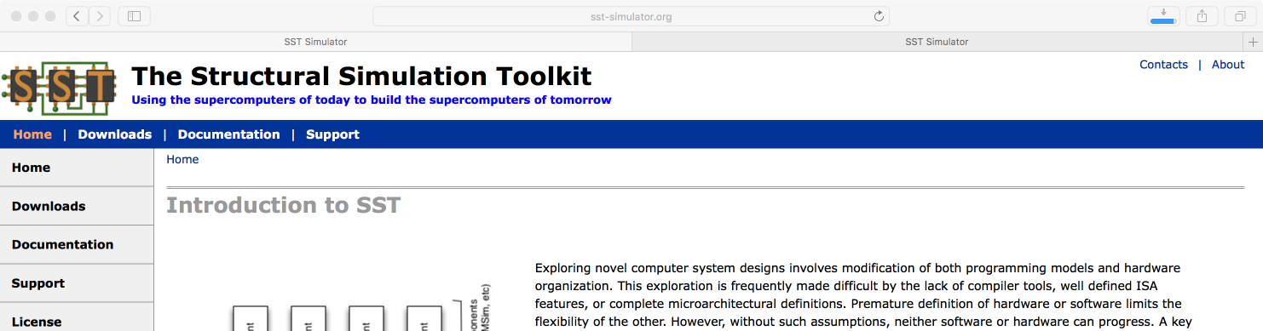
Getting and Installing SST
www.sst-simulator.org
Current release source download
Detailed build instructions including dependencies for Linux & Mac
Archived tutorial materials
https://github.com/sstsimulator
Source code checkout
Master branch – has passed testing
Devel branch – has passed basic testing

Slide 25
SST Code Structure
SST Core and SST Elements are compiled separately
Elements register with the core
External elements (not part of SST Elements) can also be registered with the core
Example at github.com/sstsimulator/sst-external-element
Source code for core:
sst-core/src/sst/core/
Source code for elements
sst-elements/src /sst/elements/
Most elements have a tests/ directory → sometimes a good starting point for example configurations

Slide 26
Running a simulation: Example
We’ll walk through the configuration file, then run it
Full intro to the elements is next but until then this example uses:
Miranda – Pattern-based memory access generator
With a stream memory access pattern generator
MemHierarchy – Caches and memory models
Just an L1 cache and memory for this example
Miranda CPU
L1 Cache
Memory
2.4GHz, issue 2 accesses/cycle
Stream triad pattern
Three 1K element arrays A,B,C
Compute C[i] = A[i] + 2*B[i]
→ 2K reads & 1K writes
2KB, 4-way set associative
2.4GHz, 2 cycle access
64B cache lines
LRU replacement MESI coherence protocol
50ns constant access latency
1GB

Slide 27
Configuration Part 1: Configure SST
Set any global simulation parameters
sst.setProgramOption(“stopAtCycle”, “100ms”)
Kill simulation (nicely!) if it runs to 100ms

Slide 28
Configuration Part 2: Declare components
Define: sst.Component(“name”, “type”)
Configure: addParams({ “parameter” : “value”, … })
core = sst.Component(“core”, “miranda.BaseCPU”)
cache = sst.Component(“L1”, “memHierarchy.Cache”)
memory = sst.Component(“memory”, “memHierarchy.MemController”)
Component name
Component type
core.addParams({
“clock” : “2.4GHz”,
“generator” : “miranda.STREAMBenchGenerator”,
“generator.n” : 1000,
})
…
# cache and memory parameters
Component parameters

Slide 29
SSTInfo: Getting component info
sst-info: information about components that the SST core has registered
Optionally filter for a specific library and/or component
$ sst-info memHierarchy.Cache
PROCESSED 1 .so (SST ELEMENT) FILES FOUND IN DIRECTORY(s) /home/sst/build/lib/sst
Filtering output on Element = “memHierarchy.Cache”
================================================================================
ELEMENT 0 = memHierarchy ()
COMPONENT 2 = Cache [MEMORY COMPONENT] (Cache Controller)
NUM PARAMETERS = 41
PARAMETER 0 = cache_frequency (Clock frequency or period with units.) [REQUIRED]
PARAMETER 1 = cache_line_size (Size of a cache line in bytes) [64]
…
NUM PORTS = 10
PORT 0 [1 Valid Events] = low_network_0 (Port to lower level caches or memory)
VALID EVENT 0 = MemHierarchy.MemEventBase
…
NUM STATISTICS = 32
STATISTIC 0 = CacheHits [count] (Total number of cache hits) Enable Level = 1
…
Definition
“REQUIRED” or default value
Parameter
Port name
Definition
Type of event(s) used on the link
Name
Units
Definition

Slide 30
Configuration Part 3: Connect the components
Create a link: sst.Link(“name”)
Connect components: connect(endpoint1, endpoint2)
Where endpoint is: (component, port, latency)
core_cache = sst.Link(“core_to_cache”)
cache_mem = sst.Link(“cache_to_memory”)
Link name
(anything unique)
core_cache.connect(
(core, “cache_link”, “100ps”),
(cache, “high_network_0”, “100ps”) )
cache_mem.connect(
(cache, “low_network_0”, “100ps”),
(memory, “direct_link”, “100ps) )
Endpoint 1
Endpoint 2

Slide 31
Running SST
Usage: sst [options] configFile.py
Common options:
-v | --verbose | Print information about core runtime
--debug-file <filename> | Send debugging output to specified file (default: sst_output)
--paritioner <zoltan | self | simple | rrobin | linear | lib.partitioner.name> | Specify the partitioning mechanism for parallel runs
-n | --num_threads <num> | Specify number of threads per rank
--model-options “<args>” | Command line arguments to send to the Python configuration file
--output-partition <filename> | Write partitioning information to <filename>
--output-dot <filename> --output-xml <filename> --output-json <filename> | Output the configuration graph in various formats to <filename>
Notes:
Is this still up to date?

Slide 32
Running the Simulation
Launch simulation
Output
Note: For more useful output, could also have enabled statistics
More later
$ sst demo.py
Simulation is complete, simulated time: 127.605 us

Slide 33
SST Elements: A Tour

Slide 34
SST Element Libraries
Elements are libraries of related components
Elements must be registered with the SST core
Tells SST where to find this set of components
Includes information on parameters and statistics for each component
SST provides a set of element libraries
Processor, network, memory, etc.
Tested for interoperability within and across libraries
Many of these libraries are compatible with external “components” such as Ramulator and Spike
See www.sst-simulator.org for more information
You can also register your own elements

Slide 35
SST 8.0 Elements
Processors
Ariel – PIN-based
Juno – simple ISA processor
Miranda – pattern generator
Prospero – trace execution
Memory Subsystem
Cassini – cache prefetchers
CramSim – DDR, HBM
MemHierarchy – caches,
Messier - NVM
Samba – TLB
VaultSimC – vaulted
Network drivers
Ember – communication patterns
Firefly – communication protocols
Hermes – MPI-like driver interface
Zodiac – trace based driver
Networks/NoCs
Merlin – flexible network modeling
Kingsley – mesh NoC
Others
scheduler – job scheduling
simpleSimulation – “car wash” example
simpleElementExample – many examples

Slide 36
Juno: Simple instruction processor
Memory
Executes a program written in simple “assembly”
32-bit wide instructions with 8 bit op codes
64-bit integer operations
ADD, SUB, DIV, MUL,
AND, OR, XOR, NOT
Jump by register value (JGT-Zero, JLZ-Zero, J-Zero)
Jump up to16 bits in either direction from current PC
Up to 253 user registers
r0 = PC
r1 = data start register
Juno
Load/Store Unit
Instruction Manager
Register File
Processor
Memory
Network/NoC
Network driver
Other

Slide 37
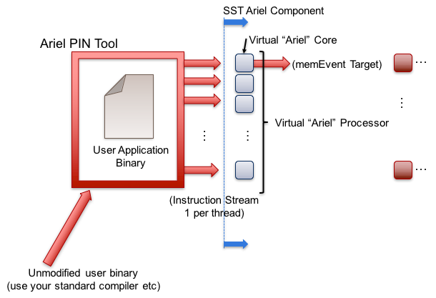
Ariel: PIN-based processor
Lightweight processor core model
Uses Intel’s PIN tools and XED decoders to analyze binaries
Runs x86, x86-64, SSE/AVX, etc. compiled binaries
Supports fixed thread count parallelism (OpenMP, Qthreads, etc.)
Passes instructions to virtual core in SST
Implements SST’s memory interface to interact with a memory model
Processor
Memory
Network/NoC
Network driver
Other

Slide 38
Ariel: Details
Pintool communicates with Ariel via shared memory IPC
Per-thread FIFO of instructions from pintool to Ariel’s virtual cores
Backpressure on FIFO halts the binary’s execution
Ariel’s virtual cores
Memory instruction oriented: execute memory instructions; all others treated as single cycle no-ops
Clocked: Reads instruction stream in chunks but processes on clock
Does not maintain dependence order or register locations (yet)!
Performs a TLB mapping of virtual-to-physical addresses
Key user knobs
Ops issued/cycle
Load/store queue size
Memory interface
Generates memEvents which can be sent to a cache model
Tracks basic statistics (request counts, split-cache line loads, etc.)
Processor
Memory
Network/NoC
Network driver
Other

Slide 39
Ariel: The Tradeoff
Pros:
Faster than cycle-accurate processor models (e.g., Gem5)
Reasonable approximation for studies on memory system performance
Especially for heavily memory-bound applications
Reasonable model of thread interactions
Cons
Slower than trace/pattern-based processor models
Does not give cycle-reproducible results
Use of threads can disturb reproducibility
Non-deterministic results
Not compatible with non-x86 binaries
Processor
Memory
Network/NoC
Network driver
Other

Slide 40
Prospero: Trace-based processor
Trace-based processor model
Reads memory ops from a file and passes to the simulated memory system
“Single core” but can use multiple trace files to emulate threaded or MPI-style applications
Supports arbitrary length reads to account for variable vector widths
Performs “first touch” virtual to physical mapping
Comes with Prospero Trace Tool to generate traces
Or can generate your own and translate to Prospero’s format
Processor
Memory
Network/NoC
Network driver
Other

Slide 41
Prospero: The Tradeoff
Pros
Faster than Ariel
Provided you can get a trace
Good for heavily memory-bound applications
Reasonable approximation to memory system performance
Cons
Traces can be very large
Requires good I/O system to store and read the trace
Traces are less flexible than actual execution
Capture a single execution stream using a single application input
Processor
Memory
Network/NoC
Network driver
Other

Slide 42
Miranda: Pattern-based processor
Extremely light-weight processor model
Generates specific memory address patterns
Supports request dependencies
Current patterns
Strided accesses (single stream)
Forward and reverse strides
Random accesses
GUPS
STREAM benchmark
In-order & out-of-order CPU
3D stencil
Sparse matrix vector multiply (SpMV)
Copy (~array copy)
Stake (beta) interfaces to the Spike RiscV simulator
Processor
Memory
Network/NoC
Network driver
Other

Slide 43
Miranda: The tradeoffs
Pros
Very lightweight – no binary, no trace
Good for applications whose address patterns are predictable
E.g., not much pointer-chasing
Cons
Need a generator for the memory pattern of interest
Requires a good understanding of the pattern
Processor
Memory
Network/NoC
Network driver
Other

Slide 44
MemHierarchy: Memory system
Collection of interoperable memory system elements
Caches
Directories
Memory controllers
Memory models (DDR, HBM, HMC, etc.
Scratchpads
NoC (network-on-chip) interfaces
Buses
Etc.
Components are cycle-accurate/cycle-level
Capable of modeling modern cache and memory subsystems
AMD “Zen”, Arm A-series, Intel Xeon/Xeon-Phi, etc.
Memory
Processor
Network/NoC
Network driver
Other

Slide 45
MemHierarchy: Details
Highly configurable
Arbitrary hierarchy depth, flexible topologies
Cache inclusivity, coherence, private/shared, etc. configurable
Single- and multi-socket configurations
Can store actual data
Prefetch via Cassini element library
Data movement
Components support direct, bus, and on-chip network (NoC) communication
Event types: read/write, atomics, LLSC, noncacheable, custom memory, etc.
Memory
Processor
Network/NoC
Network driver
Other

Slide 46
MemHierarchy: Pluggable memory models
Memory controller is an interface to memory model
Manages data values if needed (backing store)
Facilitates custom memory commands
Passes events to memory backend subcomponent
Backend: the “real” memory controller and memory
Implementations
Memory model itself
Interface to another component
Wrapper to an external simulator
Memory Controller
Backing store
Custom command handler
MemBackendConvertor
Backend
To memory component (optional)
Memory
Processor
Network/NoC
Network driver
Other

Slide 47
MemHierarchy: SST 8.0 backends
Memory (external)
CramSim (DDR, HBM)
DRAMSim2 (DDR)
PagedMulti – 2-level memory variant
FlashDIMMSim (FLASH)
HMCSim/GoblinHMC (HMC)
HBMDRAMSim2 (HBM)
HBMPagedMulti – 2-level memory variant
Messier (NVRAM)
Ramulator (DDR, HBM, HMC)
SimpleDRAM (DDR)
SimpleMem (constant latency)
TimingDRAM (DDR)
VaultSimC (HMC-like)
Plus a few that can be used with other backends to reorder requests, add latency, etc.
Memory
Processor
Network/NoC
Network driver
Other

Slide 48
Merlin: Network simulator
Low-level, flexible networking components that can be used to simulate high-speed networks (machine level) or on-chip networks
Capabilities
High radix router model (hr_router)
Topologies – mesh, n-dim tori, fat-tree, dragonfly
Many ways to drive a network
Simple traffic generation models
Nearest neighbor, uniform, uniform w/ hotspot, normal, binomial
MemHierarchy
Lightweight network endpoint models (Ember – coming up next)
Or, make your own
Network/NoC
Processor
Memory
Network driver
Other

Slide 49
Merlin Organization
Router
NIC
PC
XBAR
PC
TrafficGen
TestNIC
User Logic
LC
PC
PC
PC
PC
LC = LinkControl
PC
PC
Topology
PC = PortControl
Network/NoC
Processor
Memory
Network driver
Other

Slide 50
Ember: Network Traffic Generator
Light-weight endpoint for modeling network traffic
Enables large-scale simulation of networks where detailed modeling of endpoints would be expensive
Packages patterns as motifs
Can encode a high level of complexity in the patterns
Generic method for users to extend SST with additional communication patterns
Intended to be a driver for the Hermes, Firefly, and Merlin communication modeling stack
Uses Hermes message API to create communications
Abstracted from low-level, allowing modular reuse of additional hardware models
Network driver
Processor
Memory
Network/NoC
Other

Slide 51
Ember: Overview
Ember Motif
High Level Communication Pattern and Logic
Generates communication events
Ember Engine
User
Binary
Event to Message Call, Motif Management
Handles the tracking of the motif
Hermes API
Message Passing Semantics
Collectives, Matching etc
Firefly
Packetization and Byte Movement Engine
Generates packets and coordinates with network
Merlin Network
Flit Level Movement, Routing, Delivery
Moves flits across network, timing, etc.
Network driver
Processor
Memory
Network/NoC
Other

Slide 52
Ember: Motifs
Motifs are lightweight patterns of communication
Tend to have very small state
Extracted from parent applications
Models as an MPI program (serial flow of control)
Many motifs acting in the simulation create the parallel behavior
Example motifs
Halo exchanges (1, 2, and 3D)
MPI collections – reductions, all-reduce, gather, barrier
Communication sweeping (Sweep3D, LU, etc.)
Network driver
Processor
Memory
Network/NoC
Other

Slide 53
Ember: Motifs (continued)
The EmberEngine creates and manages the motif
Creates an event queue which the motif adds events to when probed
The Engine executes the queued events in order, converting them to message semantic calls as needed
When the queue is empty, the motif is probed again for events
Events correspond to a specific action
E.g., send, recv, allreduce, compute-for-a-period, wait, etc.
Network driver
Processor
Memory
Network/NoC
Other

Slide 54
Firefly: Network traffic
Purpose: Create network traffic, based on application communication patterns, at large scale
Enables testing the impact of network topologies and technologies on application communication at very large scale
Scales to 1 million nodes
Supports multiple “cores” per Node
Interaction between cores limited to message passing
Supports space sharing of the network
Multiple “apps” running simultaneously
Network driver
Processor
Memory
Network/NoC
Other

Slide 55
Firefly: Simulating large networks
A network node consists of
Driver (the “application”)
NIC
Router
Nodes are connected together via routers to form a network
Fat tree, torus, etc.
Firefly is the interface between the driver and the router
Message passing library → Firefly Hades
NIC → Firefly NIC
Ember
(driver)
Firefly Hades
Firefly NIC
Merlin Router
Network driver
Processor
Memory
Network/NoC
Other

Slide 56
Scheduler: Job scheduling
Models HPC system-wide job scheduling
Three components
Sched: schedules and allocates resources for a stream of jobs
Node: runs scheduled jobs on their allocated resources
FaultInjection: injects failures onto the resources
The scheduler can be a stand-alone element library
The schedComponent and nodeComponent must be used together
The faultInjectionComponent is optional
Can be used with Ember/Firefly/Merlin stack
Examine topology aware scheduling and allocation
Other
Processor
Memory
Network/NoC
Network driver

Slide 57
Other Libraries
More information on these and other element libraries and external components is available on the wiki
www.sst-simulator.org

Slide 58
Extending SST

Slide 59
Extending SST
SST is designed for extensibility
Mix custom components with existing ones
Creating new element libraries and components
Wrapping existing simulators to interact with other SST components
We recommend that libraries be built outside the elements source tree
Helpful information
Example element library
Components demonstrating links, ports, clocks, event handling, etc.
sst-elements/src/sst/elements/simpleElementExample/
Wiki
Getting Started Extending SST (a little out of date)
Building Element Libraries outside SST source tree
Tutorials

Slide 60
Extending SST
SST designed to be extensible
Components/subcomponents can be added without touching SST Elements
Many users start with SST Elements and then build their own customized internal libraries
Partially or completely replacing SST Element functionality
Modular design supports distributed workflow
Components/subcomponents can be built in isolation so long as interfaces are established
Many approaches
Build new set of components from scratch
Start from existing elements and replace components/subcomponents to meet your needs
Wrap existing simulators and insert as components or subcomponents
Modularity supports a distributed workflow
Components

Slide 61
Designing components for performance and scalability
Most of the time, these concerns are secondary. But if you run into problems…
Higher link latencies reduce synchronization frequency
Push event delay latencies onto links where possible, instead of modeling internally
Temporarily de-clock idle clocked components
Note: De-clocking during a clock handler is very cheap
Re-enable when an event handler is triggered

Slide 62
Use Cases

Slide 63
SST: Use cases
SST has been used for a wide variety of studies
Analyzing memory access patterns
Comparing multi-level memory management techniques
Evaluating application performance with different NVRAM organizations
Design space exploration across network bandwidths and node performance
Designing job scheduling algorithms for use across thousands of nodes
Next: Some studies using SST

Slide 64
Case #1: Multi-level memory
Future memory systems will be Multi-Level Memory
Multiple kinds of memory in the same system (DDR, HBM, NVRAM)
MLM can potentially offer more “usable” bandwidth, less cost
Challenges:
substantial software and hardware (co-)design
no “one size fits all”
SST can explore HW & SW organization
AMD
Marvell

Slide 65
Analyzing Memory Accesses
Capture post-cache accesses
Setup:
“Quads” of 4 cores
Histogram generator implemented as a prefetcher
l2SnoopParams = {
"prefetcher": "cassini.AddrHistogrammer",
"prefetcher.histo_bin_width": 4096,
"prefetcher.heap_begin": "1 GiB",
"prefetcher.heap_end": "9 GiB"
}
Notes:
Made the bins 4 KB wide to prevent the histograms from bloating with too many bins. Also, the pdf generation and rendering were taking forever when the bins were only 64 B.

Slide 66
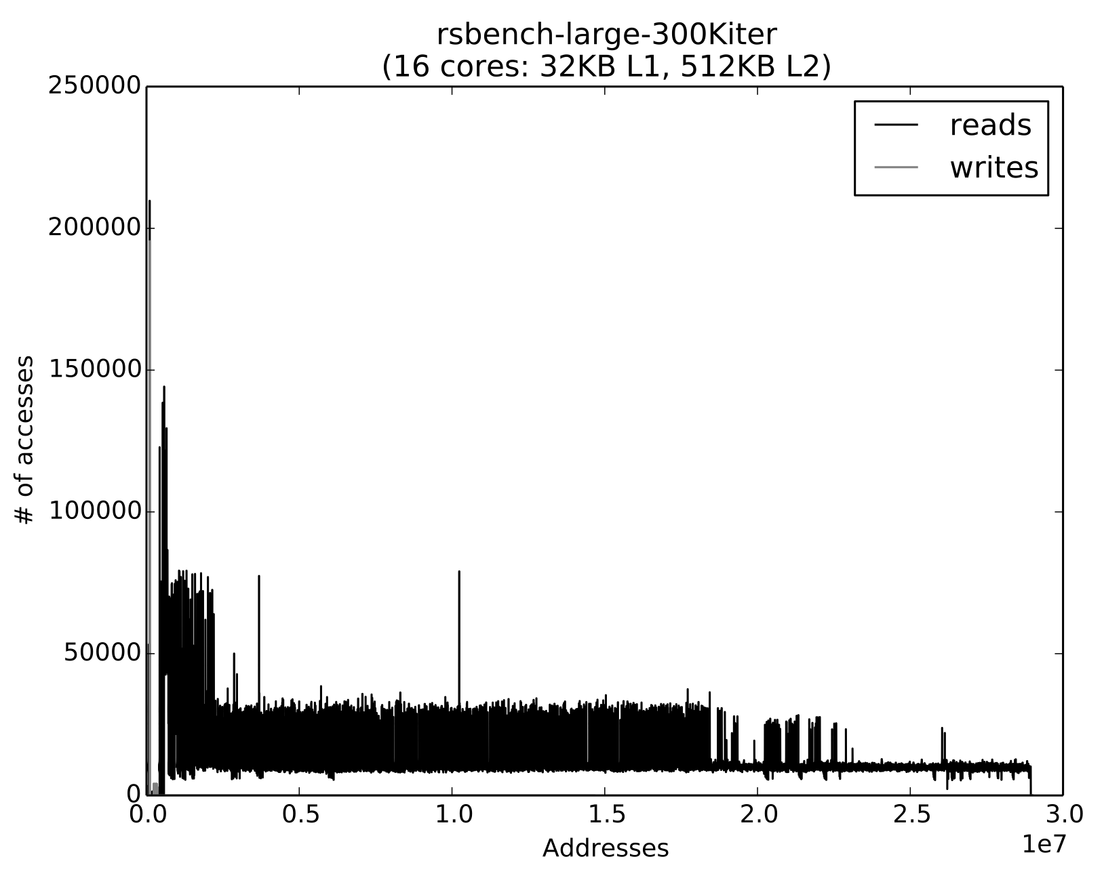

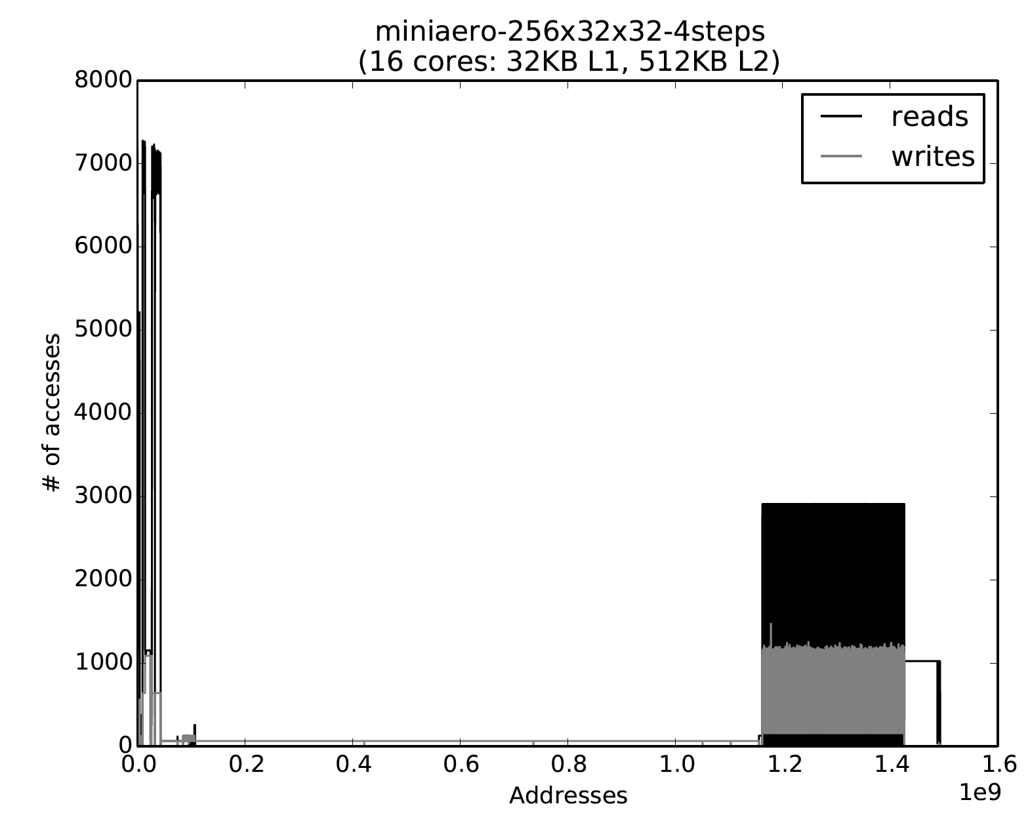
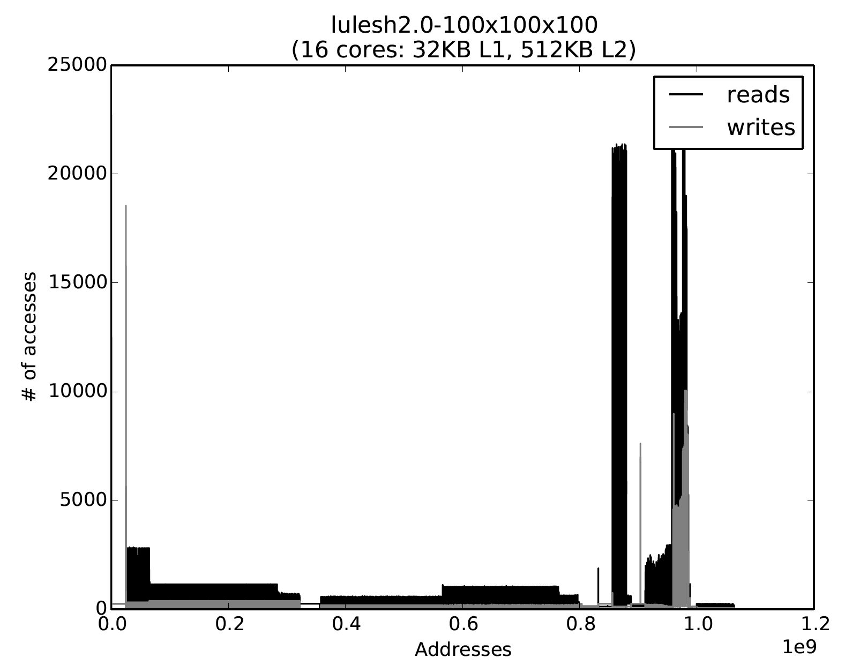

Analysis: Diverse Page Access Patterns
Regular
Irregular
Physical address histograms
Few, Well-defined Regions
Multiple
Regions
Irregular
Notes:
Note: we are looking at physical addresses. There are no large gaps as with the virtual addresses. Ariel assigns a physical page on use. Therefore all the physical pages seen are actually in use.

Slide 67
Multi-Level Memory Simulation
Multiple memory types:
DDR DRAM (DramSim)
HMC-like Stacked Memory (VaultSim)
NVRAM (NVDIMMSim)
Addresses can be interleaved, or blocked between memory types
dc.addParams({
"addr_range_start": start_pos,
"addr_range_end": end_pos,
"interleave_size": interleave_size/1024,
"interleave_step": interleave_step,
"entry_cache_size": 128*1024,
"clock": memclock,
"network_address": netPort
})

Slide 68
MLM Explorations
Analysis of application memory use distribution
Quick exploration of “Naïve” address assignment, capacity ratios on performance
Not shown: Feedback results from histograms to determine address assignment

Slide 69
MLM Automatic Page Moves
Can treat “fast” memory as a cache / page store
OS / Runtime / HW moves pages between memory levels
Early Exploration
“Addition” policy more important than “Replacement” policy
i.e. What you put it is more important than what you take out

Slide 70
Case #2: Network
What is the network latency achieved by different platforms during a 3D halo exchange?
Halo exchange: Exchange boundary data with neighbors
Platform 1: “Fat” nodes – Eight 20TF/s cores per node
Platform 2: “Medium” nodes – Two 20TF/s cores per node
Platform 3: “Thin” nodes – One 10TF/s core per node
Evaluate for 1K to 64K participating nodes
Evaluate at three different link bandwidths
12.5GB/s, 50GB/s, 125GB/s

Slide 71
Network: Simulation setup
Use SST Ember to model nodes
Lightweight model focused on communication pattern
Estimates compute time using the node’s FLOPS
Detailed model of communication
Use SST Firefly to model the NIC
Use SST Merlin to model the network
Detailed, cycle-accurate models for network (routers, links, etc.)

Slide 72
Link bandwidth = 12.5GB/s

Slide 73
Link bandwidth = 50GB/s

Slide 74
Link bandwidth = 125GB/s

Slide 75
Case #3: Scheduling
PaCMap: Topology mapping of unstructured communication patterns onto non-contiguous allocations (ICS 2015)
Tuncer, Leung, and Coskun
Problem: Want to map a job’s tasks to nodes in a way that reduces communication overhead
Two optimizations: (1) allocate nodes to a job and (2) map a job’s tasks to its allocated nodes
Traditionally: communication pattern-unaware allocation followed by communication pattern-aware mapping
But, overhead affected by both allocation and mapping
Challenges: Non-contiguous allocation and irregular communication
PaCMap: Joint, communication-aware, allocation and mapping

Slide 76
PaCMap: Simulation challenge
Big challenge for simulation
System has 30K-90K+ cores across thousands of nodes
Workloads run 1K-3K jobs, each with up to 115K tasks
Interested in system performance over a period of two weeks
Decision for current job affects future job’s performance
Experimental methodology
Workloads: Trace-based
Create macro-level performance estimate
Coarse-grained performance estimate calibrated using data from real hardware
Tradeoff fidelity for simulation speed
Uses scheduler, METIS, LibTopoMap for partitioning and scheduling

Slide 77
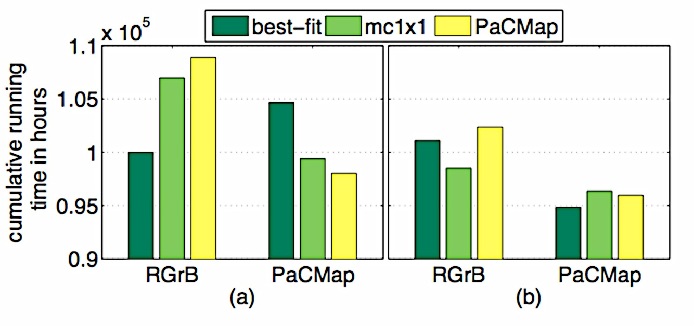
PaCMap: Results
Cumulative running time for jobs in (a) LLNL-Atlas and (b) CEA-Curie
for different allocator-mapper pairs
PaCMap reduces cumulative running time by 2-3% (3000 node hours) over two weeks
For jobs with 1K+ tasks, PaCMap reduces network traffic volume by up to 30% (not shown)

Slide 78
Future Directions

Slide 79


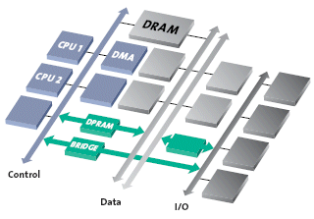
Future/Current Directions
HDL Simulation via Verilator or Chisel
Low-level hardware design
Path to tape-out (Chisel)
New Processor Models
RISC V
Improved NoC Models (Kingsley)
Faster Performance
NoC QoS

Slide 80
Future Directions: Neural Inspired
Custom processors / accelerators
Sandia Spiking Temporal Processing Unit
Programmability – Fugu framework
Explore
System Integration Issues
Architectural Bottlenecks
Programmability / portability
Allows…
Exploration of conventional / NIC (Neuro-inspired compute_ interface (e.g. different message routing protocols)
Allows NIC to connect to conventional processors, network, memory, etc… (explore ’speeds and feeds’)
Parallel simulation: SST can utilize thread- and MPI-level parallelism
Notes:
Beyond Moore

Slide 81
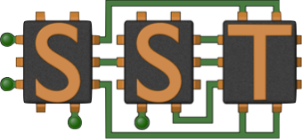


Future Directions: More Framework Integration
Beyond Moore Computing
New Architectures (e.g. Neuromorphic)
New Devices (e.g. Memristor)
New Programming Models / Algorithms
Requires Cross-Stack Optimization
Multi-scale Codesign Framework
Device to System Level
Use of Dakota / INDRA / Machine Learning to automate design space exploration
Requires Inter-disciplinary approach
SST Simulator as “Clearinghouse of Ideas”
Common language of exploration
Multiscale Codesign Framework
Semi- automated analytic capabilities
Requests
Model repository
R&D Stakeholders
Research community
Models
Generates
Reports
MCF Data
MCF Service
Notes:
The DOE and other institutions are making a push in to Beyond Moore Computing. This ranges from new architectures (e.g. neuromorphic inspired computing) to new devices (e.g. memristors)
A critical part of this process is that major changes may be required in all levels of the hardware stack, from the device level, to the circuit, to the system (not to mention software). We are working on building a simulation and modeling environment to allow automatic optimization across the stack using existing optimization tools such as Dakota. More importantly, we will be designing interfaces so that a common infrastructure can be used by device designers and architects to explore ideas.

Slide 82
Finally: Getting help
SST wiki contains lots of information (www.sst-simulator.org)
Downloading, installing, and running SST
Element libraries and external components
Guides for extending SST
Information on APIs
Information about current development efforts
Past tutorial slides and exercises
SST Github
Current development
Issues track user questions as well as development plans, bugs, etc.

Slide 83
Wrap-up
SST is a parallel, flexible simulation framework
Can simulate many systems at many granularities
Capable of simulating modern architectures
Modular design for extensibility
Please keep us posted on your uses of SST as well as any capabilities you’ve added or would like to see added
What Can SST Do For YOU?
What can we document for you
Thank you for attending!

Slide 84
Extra: Other Libraries

Slide 85
Cassini: Prefetchers
Library of subcomponents that plug into MemHierarchy caches
Via “CacheListener” interface
Strided prefetch

Slide 87
CramSim

Slide 88
VaultSimC

Slide 89
Messier

Slide 90
Samba

Slide 91
Kingsley

Slide 92
Zodiac

Slide 93


The SST Project
Goals
Become the standard architectural simulation framework for HPC
Be able to evaluate future systems on DOE/DOD workloads
Use supercomputers to design supercomputers
Status
Current Release (8.0)
SST Core – simulation framework
SST Elements/Macro - basic components
Source code on github
Supported on Linux and OSX
Technical Approach
Parallel
Parallel Discrete Event core with conservative optimization over MPI/Threads
Multiscale
Detailed and simple models for processor, network, & memory
Interoperability
DRAMSim, Spike, HMCSim, etc.
Memory models, routers, NICs, schedulers
Open
Open Core, non-viral, modular
Consortium
“Best of Breed” simulation suite
Combine Lab, Academia, & Industry

